Slide 1
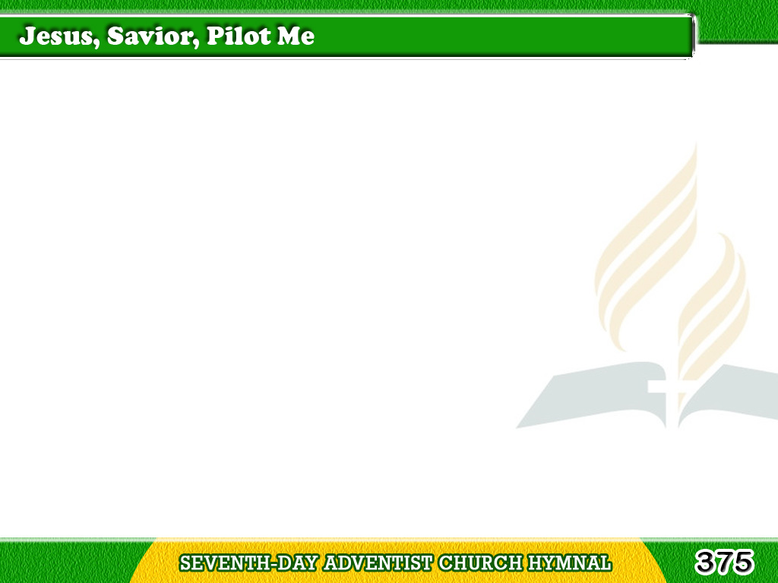
1/3
Jesus, Savior, pilot me
Over life’s tempestuous sea;
Unknown waves before me roll,
Hiding rock
and treacherous shoal;
Tagalog
Version

Slide 2
1/3
Chart and compass
come from Thee;
Jesus, Savior, pilot me.
Tagalog
Version

Slide 3
2/3
As a mother stills her child,
Thou canst hush the ocean wild;
Boisterous waves obey Thy will
Tagalog
Version

Slide 4
2/3
When Thou sayest to them,
“Be still.”
Wondrous Sovereign of the sea,
Jesus, Savior, pilot me.
Tagalog
Version

Slide 5
3/3
When at last I near the shore,
And the fearful breakers roar
‘Twixt me and the peaceful rest,
Tagalog
Version

Slide 6
3/3
Then, while leaning
on Thy breast,
May I hear Thee say to me,
“Fear not, I will pilot thee.”
Tagalog
Version

